Slide 1
Prodify
Team Conquerors

Slide 2



About Zomato
A platform to connect customers, restaurant partners and delivery partners
Customers
Restaurants
Delivery
Platform to search and discover restaurants, read and write customer generated reviews, order food, book a table and make payments while dining-out at restaurants
Provide restaurant partners with industry-specific marketing tools which enable them to engage and acquire customers to grow their business
Provide a reliable and efficient last mile delivery service while providing our delivery partners with transparent and flexible earning opportunities
1.5 Mn
32.1 Mn
Rs. 455
12000
Orders a day
Monthly Active Users
Average Order Value
No. of Restaurant
Partners

Slide 3


Comparison
Efficiency
Brand Cannabalism
Experience specially tailored to food delivery. Can operate more than one brand making it easier to batch prep ingredients.
01
01
With the minority stake Zomato already holds in BlinkIt, it could end up eating its own revenue entering this space.
Finance
Flexible with location eliminates rental budget. Labor cost of hiring servers also is an added advantage.
Competitive marketspace
02
02
Cloud Kitchen
Grocery
With a large number of competitors already in this space, it is difficult for a new entrant to be able to enter the space.
Flexible Menu
Low order frequency coupled with very little margin for the company makes this a problematic landscape to enter.
Order Frequency
03
03
For Zomato, the colossal amount of data on feeding patterns could prove very useful allowing them to customise their menu based on locality and time.

Slide 4
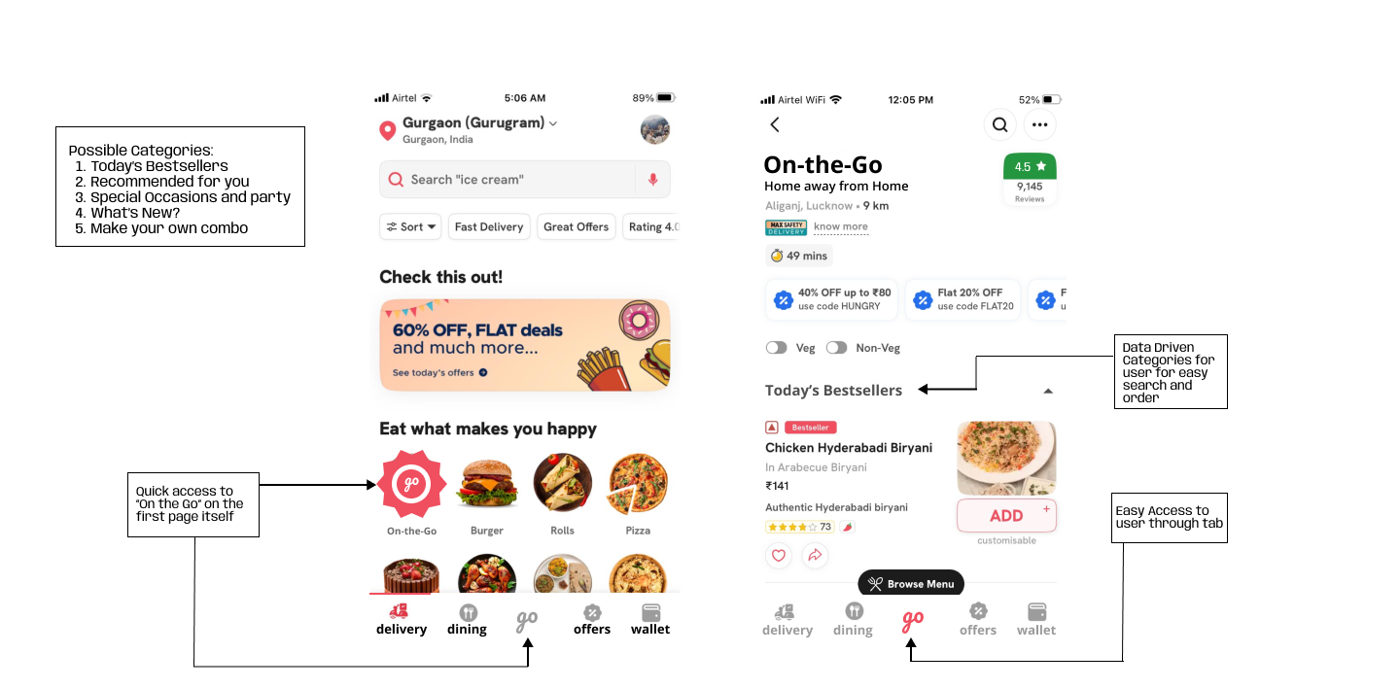
UI / UX

Slide 5





GTM Strategy
The beta will be rolled out as a pilot program to a select group of users and engagement tracked
Complete Launch of MVP with promotions across all channels. User engagement tracked to make real time decisions.
Soft launch & Activation
Promotion & Complete Launch
Feature Dev & Testing
Refinement
Tracking
The On-the-Go feature will be developed and tested
Based on metric evaluations & existing data, the feature will need to be refined, customer experience improved and workflow simplified
Essential metrics need to be tracked and new features or categories need to be added to keep the user engaged

Slide 6
Comprehensive Roadmap
Market Research
Feature Development
Pilot Launch
Feedback & Final Release
Conduct detailed market research to understand customer preference for dine-in, or cloud kitchens
Target population in Tier 1 metro cities, IT hubs, universities and colleges
Income group for research may include middle class, and upper middle class
Gamifying the option, including questions and spin the wheel
Quiz question include: Top 5 dishes at the moment in a location, most ordered dishes, etc.
Dynamic discount based on number of correct answers received (range: 10-20%)
Discount coupons will be valid for a limited time duration (e.g. – 10-12 hrs)
Identifying top 5 dishes in the target region
Target universities & IT Hubs for pilot test
Universities: Launching cloud kitchen under Zomato’s OTG
IT hubs: Convert non-profitable restaurants under Zomato’s OTG
Pilot version option to go to restaurant version vs “On the Go” version
Collect feedbacks from pilot for 10-12 weeks
Calculate profitability and success metrics on the above data
Needful changes, modifications based on the feedback received
Launching the final version

Slide 7
Success Metrics
Order Density
A
Number of orders from the “Go” Tab / Number of orders on Zomato
Average Order Time
B
Average time taken from opening of “Go” tab to when order is placed
Drop-Off rates
C
Number of users opening the tab but not ordering
Visit Rate
D
Number of users opening “Go” tab / Total number of App users
User Retention Rate
E
Number of users reordering from “Go” / Number of users who have ordered from “Go”

Slide 8


thank you
💛
Your favorite Meal Companion for 2 AM Conversations

